Slide 1
Managing Software Development Teams
By: Alex Lleva

Slide 2
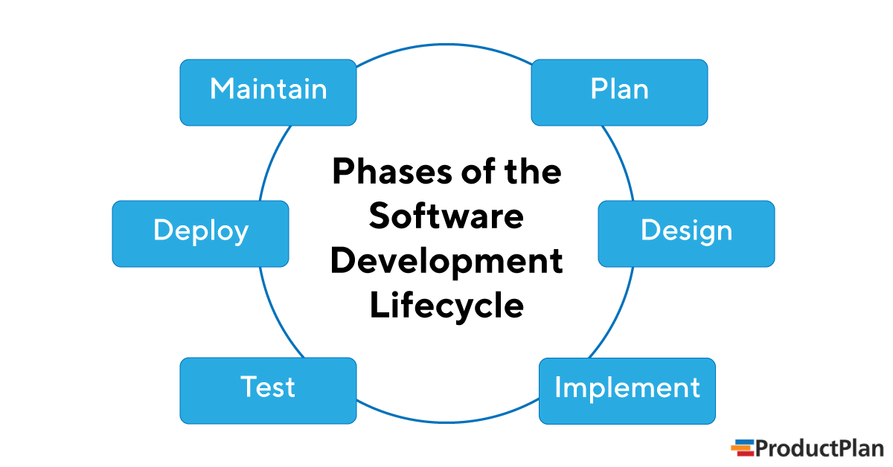
Software Development Life Cycle

Slide 3
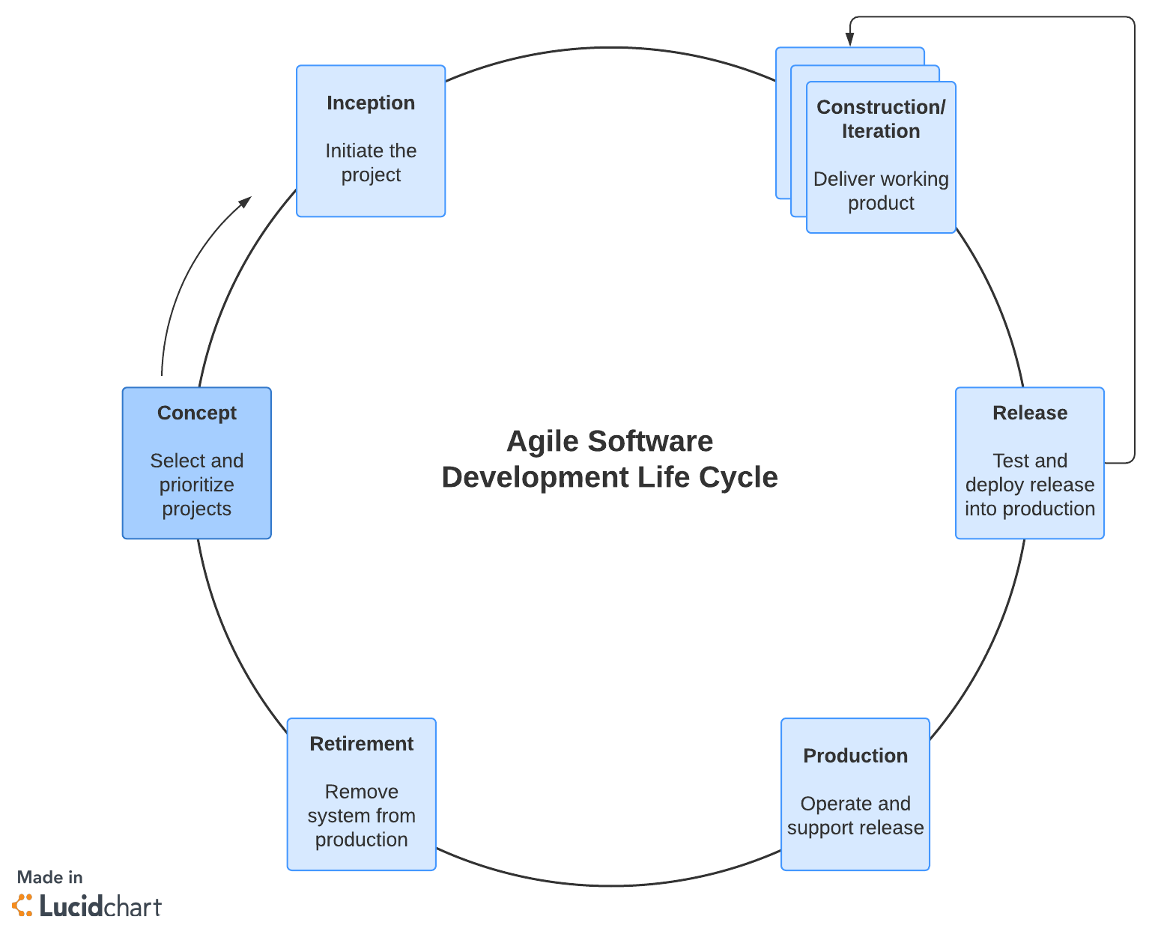
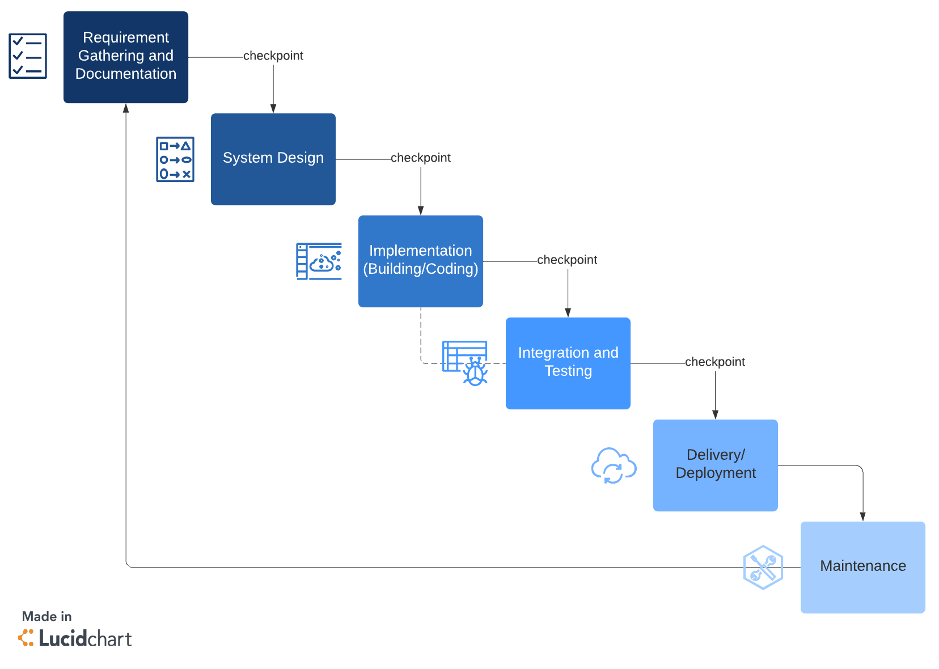
Software Development Lifecycle Models
Waterfall - straightforward approach: finish one phase, then move on to the next. No going back.
Agile - produces ongoing release cycles, each featuring small, incremental changes from the previous release

Slide 4
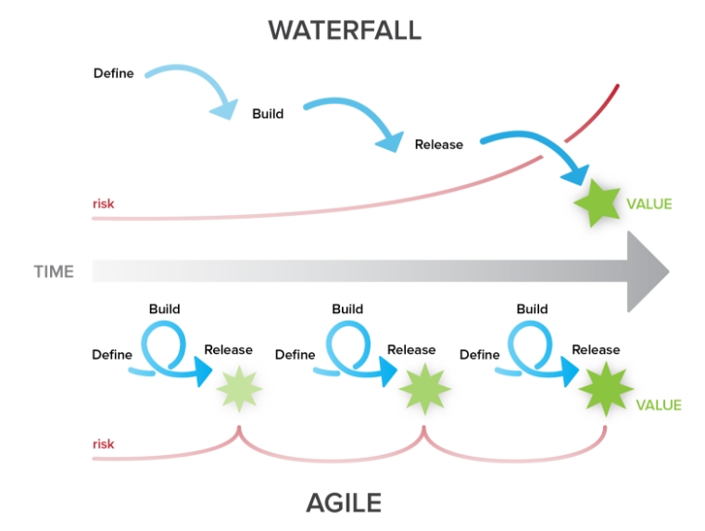
Waterfall Vs. Agile
blog.ganttpro.com

Slide 5
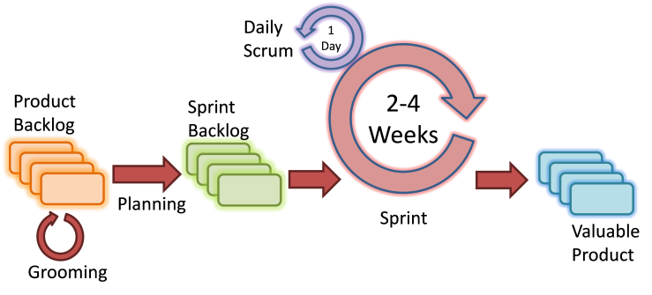
6 Steps in Agile Methodology
The goal of Agile is to produce shorter development cycles and more frequent product releases. This shorter time frame enables project teams to react to changes in the client’s needs more effectively.
Project planning
Product roadmap creation
Release planning
Sprint planning
Daily stand-ups
Sprint review and retrospective
medium.com

Slide 6
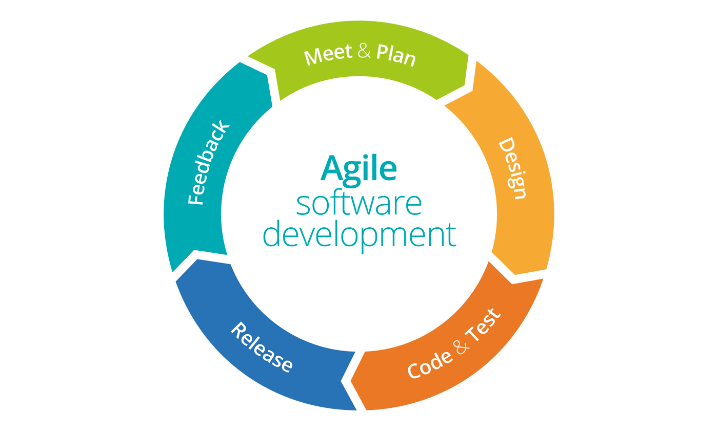
Phases of Agile Methodologies
Concept - Kick off meeting to define scope and prioritize projects
Inception - Diagram requirements and initiate the project
Iteration - Build the bare functionality of the product
Plan
Develop
Test/QA
Deliver iteration
Incorporate feedback
Release - iteration into production
Test the system
Address any defects
Finalize system and user documentation
Maintenance - keep the system running smoothly and resolve any new bugs
Retirement - remove the system release from production
BPM Microsystems

Slide 7
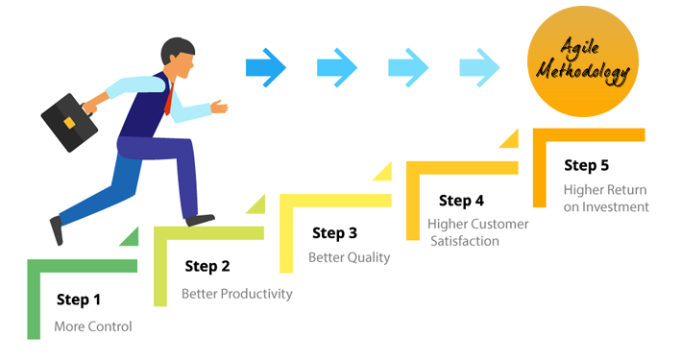
Conclusion
Using Agile methodologies helps to:
Give the team more control over the project
Focus on customers and results
Improve project quality
Adapt to changes and scalability
Offers predictability for project managers
Show teams how to use tools to the best of their ability
Improve project organization and productivity
Try using Agile methodologies when you’re developing your next project
Denysys Corporation

Slide 8
References
“The Agile Software Development Life Cycle.” Wrike Agile Guide, https://www.wrike.com/agile-guide/agile-development-life-cycle/.
Half, Robert. “6 Basic SDLC Methodologies: Which One Is Best?” 6 Basic SDLC Methodologies | Robert Half, 23 Nov. 2021, https://www.roberthalf.com/blog/salaries-and-skills/6-basic-sdlc-methodologies-which-one-is-best.
Keita, Billie. “Top 5 Reasons Why Organizations Are Adopting Agile Methodologies.” Invensis Learning Blog, 3 Nov. 2020, https://www.invensislearning.com/blog/why-do-companies-adopt-agile-methodologies/.
“The Stages of the Agile Software Development Life Cycle.” Lucidchart Blog, 10 Aug. 2018, https://www.lucidchart.com/blog/agile-software-development-life-cycle.
“What Is the Software Development Lifecycle?” ProductPlan, 12 Aug. 2021, https://www.productplan.com/learn/software-development-lifecycle/.

